Slide 1
Programming With C++/R
DST102TC
Huakang Li
Huakang.li@xjtlu.edu.cn
School of AI and Advanced Computing
Notes:
English Title: Uppercase, Calibri size 60, XJTLU Navy
English Subtitle: Uppercase, Calibri size 36, XJTLU Navy

Slide 2
Chapter 12
templates, vectors and stacks
Notes:
English Title: Uppercase, Calibri size 60, XJTLU Navy
English Subtitle: Uppercase, Calibri size 36, XJTLU Navy

Slide 3
Objectives
To know the motivation and benefits of templates (§12.2).
To define a template function with type parameters (§12.2).
To develop a generic sort function using templates (§12.3).
To develop generic classes using class templates (§§12.4-12.5).
To use the C++ vector class as a resizable array (§12.6).
To replace arrays using vectors (§12.7).

Slide 4
Templates Basics
Let us begin with a simple example to demonstrate the need for templates.
Suppose you want to find the maximum of two integers, two doubles, and two characters, you might write three overloaded functions as follows:

Slide 5
Templates Basics
int maxValue(const int& value1, const int& value2)
{
if (value1 > value2)
return value1;
else
return value2;
}

Slide 6
Templates Basics
double maxValue(const double& value1, const double& value2)
{
if (value1 > value2)
return value1;
else
return value2;
}

Slide 7
Templates Basics
char maxValue(const char& value1, const char& value2)
{
if (value1 > value2)
return value1;
else
return value2;
}

Slide 8
Generic Function
template<typename GenericType>
GenericType maxValue(
const GenericType& value1, const GenericType& value2)
{
if (value1 > value2)
return value1;
else
return value2;
}

Slide 9
Generic Functions
C++ enables you to define a function template with generic types. Listing 12.1 defines a template function for finding a maximum value between two values of a generic type.

Slide 10
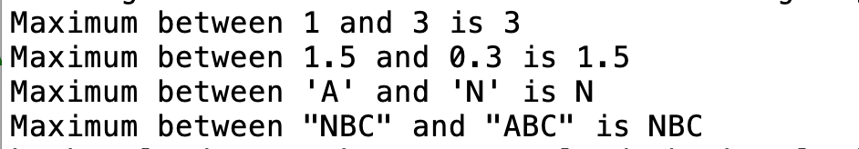
GenericMaxValue.cpp
#include <iostream>
#include <string>
using namespace std;
template<typename T>
T maxValue(const T& value1, const T& value2)
{
if (value1 > value2)
return value1;
else
return value2;
}
int main()
{
cout << "Maximum between 1 and 3 is " << maxValue(1, 3) << endl;
cout << "Maximum between 1.5 and 0.3 is "
<< maxValue(1.5, 0.3) << endl;
cout << "Maximum between 'A' and 'N' is "
<< maxValue('A', 'N') << endl;
cout << "Maximum between \"NBC\" and \"ABC\" is "
<< maxValue(string("NBC"), string("ABC")) << endl;
return 0;
}

Slide 11
match parameter
The generic maxValue function can be used to return a maximum of two values of any type, provided that
The two values have the same type;
The two values can be compared using the > operator.

Slide 12
<typename T> preferred
You can use either <typename T> or <class T> to specify a type parameter.
Using <typename T> is better because <typename T> is descriptive.
<class T> could be confused with class declaration.

Slide 13
multiple type parameters
Occasionally, a template function may have more than one parameter. In this case, place the parameters together inside the brackets, separated by commas, such as <typename T1, typename T2, typename T3>.

Slide 14
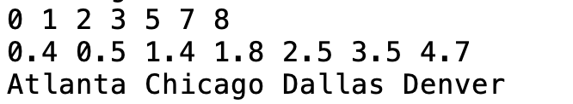
GenericSort.cpp
template<typename T>
void printArray(const T list[], int listSize)
{
for (int i = 0; i < listSize; i++)
{
cout << list[i] << " ";
}
cout << endl;
}
int main()
{
int list1[] = {3, 5, 1, 0, 2, 8, 7};
sort(list1, 7);
printArray(list1, 7);
double list2[] = {3.5, 0.5, 1.4, 0.4, 2.5, 1.8, 4.7};
sort(list2, 7);
printArray(list2, 7);
string list3[] = {"Atlanta", "Denver", "Chicago", "Dallas"};
sort(list3, 4);
printArray(list3, 4);
return 0;
}
#include <iostream>
#include <string>
using namespace std;
template<typename T>
void sort(T list[], int listSize)
{
for (int i = 0; i < listSize; i++)
{
// Find the minimum in the list[i..listSize-1]
T currentMin = list[i];
int currentMinIndex = i;
for (int j = i + 1; j < listSize; j++)
{
if (currentMin > list[j])
{
currentMin = list[j];
currentMinIndex = j;
}
}
// Swap list[i] with list[currentMinIndex] if necessary;
if (currentMinIndex != i)
{
list[currentMinIndex] = list[i];
list[i] = currentMin;
}
}
}

Slide 15
developing generic function
When you define a generic function, it is better to start with non-generic function, debug and test it, and then convert it to a generic function.

Slide 16
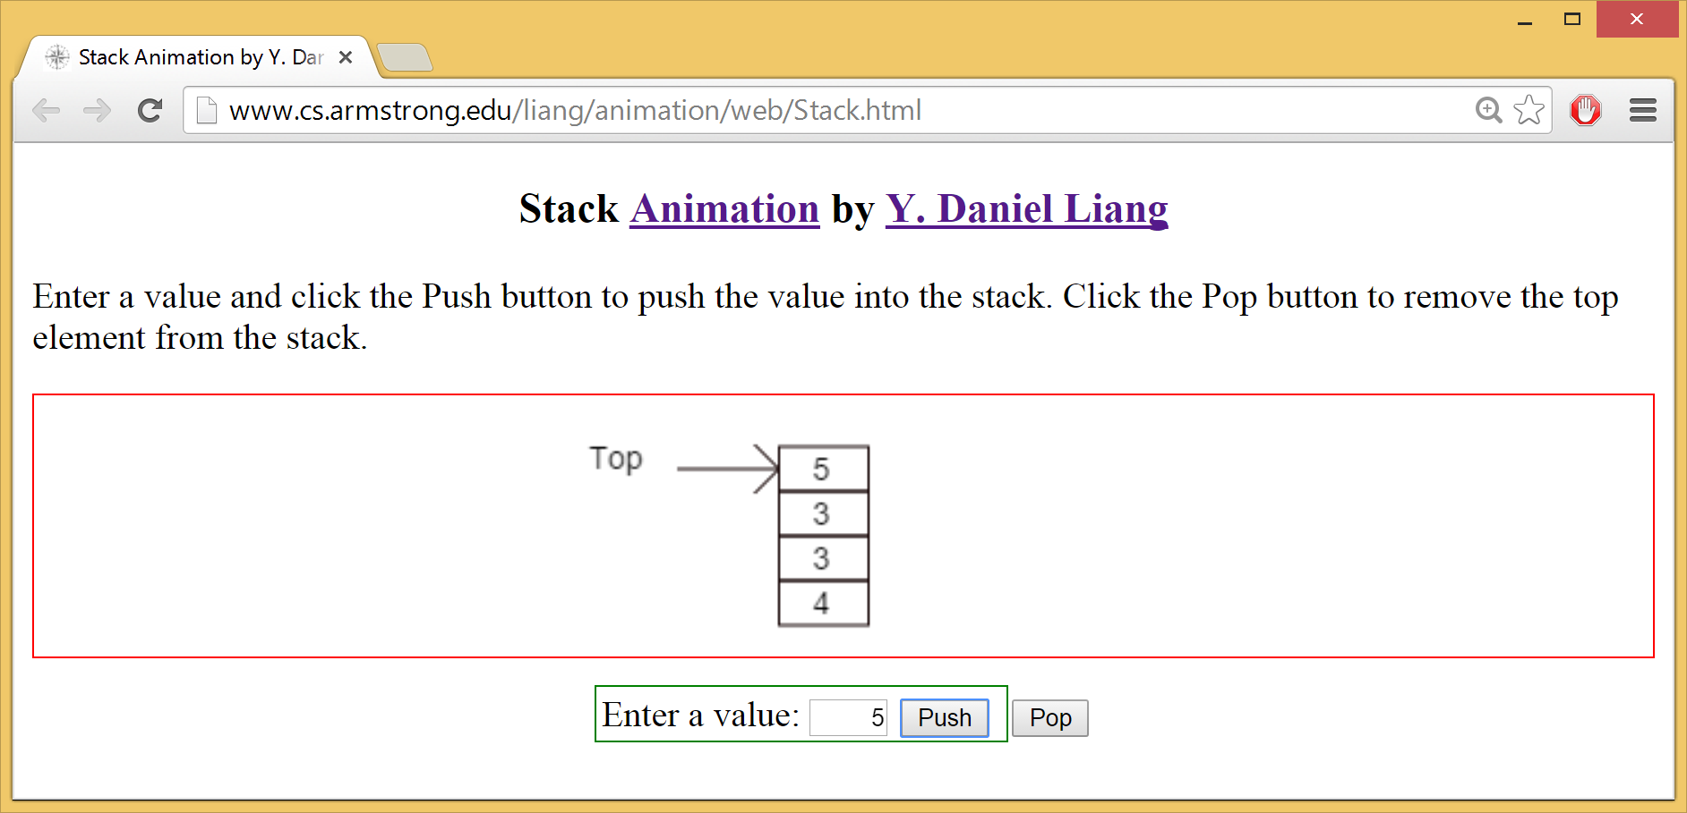
Stack Animation
http://www.cs.armstrong.edu/liang/animation/web/Stack.html

Slide 17
Class Templates

Slide 18

GenericStack.h
TestGenericStack.cpp
#ifndef STACK_H
#define STACK_H
template<typename T>
class Stack
{
public:
Stack();
bool empty() const;
T peek() const;
void push(T value);
T pop();
int getSize() const;
private:
T elements[100];
int size;
};
template<typename T>
Stack<T>::Stack()
{
size = 0;
}
template<typename T>
bool Stack<T>::empty() const
{
return (size == 0);
}
template<typename T>
T Stack<T>::peek() const
{
return elements[size - 1];
}
template<typename T>
void Stack<T>::push(T value)
{
elements[size++] = value;
}
template<typename T>
T Stack<T>::pop()
{
return elements[--size];
}
template<typename T>
int Stack<T>::getSize() const
{
return size;
}
#endif
#include <iostream>
#include <string>
#include "GenericStack.h"
using namespace std;
int main()
{
// Create a stack of int values
Stack<int> intStack;
for (int i = 0; i < 10; i++)
intStack.push(i);
while (!intStack.empty())
cout << intStack.pop() << " ";
cout << endl;
// Create a stack of strings
Stack<string> stringStack;
stringStack.push("Chicago");
stringStack.push("Denver");
stringStack.push("London");
while (!stringStack.empty())
cout << stringStack.pop() << " ";
cout << endl;
return 0;
}

Slide 19
compile issue
GenericStack.h combines class header with implementation into one file.
Normally, you put class definition and class implementation into two separate files (.h and .cpp).
However, it is safer to put them together for class templates, because some compliers cannot compile them separately.

Slide 20
default type
C++ allows you to assign a default type for a type parameter in a class template.
For example, you may assign int as a default type in the generic Stack class as follows:
template<typename T = int>
class Stack
{
...
};

Slide 21
default type
You can now declare an object using the default type like this:
Stack<> stack; // stack is a stack for int values
You can only use default type in class templates, not in function templates.

Slide 22
nontype parameter
You can also use nontype parameters along with type parameters in a template prefix.
For example, you may define the array capacity as a parameter for the Stack class as follows:
template<typename T, int capacity>
class Stack
{
...
private:
T elements[capacity];
int size;
};

Slide 23
static members
You can define static members in a template class. Each template specialization has its own copy of a static data field.

Slide 24
Improving the Stack Class
There is a problem in the Stack class. The elements of the stack are stored in an array with a fixed size 100 (see line 16 in Listing 12.4).
So, you cannot store more than 100 elements in a stack.
You may change 100 to a larger number. But this would waste space if the actual stack is small.
One way to resolve this dilemma is to allocate more memory when needed.

Slide 25
ImprovedStack.h
template<typename T>
Stack<T>::Stack(const Stack& stack){
elements = new T[stack.capacity];
size = stack.size;
capacity = stack.capacity;
for (int i = 0; i < size; i++)
{
elements[i] = stack.elements[i];
}
}
template<typename T>
Stack<T>::~Stack(){
delete [] elements;
}
template<typename T>
bool Stack<T>::empty() const
{
return (size == 0);
}
template<typename T>
T Stack<T>::peek() const
{
return elements[size - 1];
}
template<typename T>
void Stack<T>::push(T value)
{
ensureCapacity();
elements[size++] = value;
}
template<typename T>
void Stack<T>::ensureCapacity()
{
if (size >= capacity)
{
T* old = elements;
capacity = 2 * size;
elements = new T[size * 2];
for (int i = 0; i < size; i++)
elements[i] = old[i];
delete [] old;
}
}
template<typename T>
T Stack<T>::pop()
{
return elements[--size];
}
template<typename T>
int Stack<T>::getSize() const
{
return size;
}
#endif
#ifndef IMPROVEDSTACK_H
#define IMPROVEDSTACK_H
template<typename T>
class Stack
{
public:
Stack();
Stack(const Stack&);
~Stack();
bool empty() const;
T peek() const;
void push(T value);
T pop();
int getSize() const;
private:
T* elements;
int size;
int capacity;
void ensureCapacity();
};
template<typename T>
Stack<T>::Stack(): size(0), capacity(16)
{
elements = new T[capacity];
}

Slide 26
The C++ vector Class
The preceding two examples use arrays to store students and int values. There is a serious limitation: the array size is fixed in the class declaration.
C++ provides the vector class, which is more flexible than arrays. You can use a vector object just like an array, but a vector’s size can grow automatically if needed.

Slide 27
The C++ vector Class

Slide 28
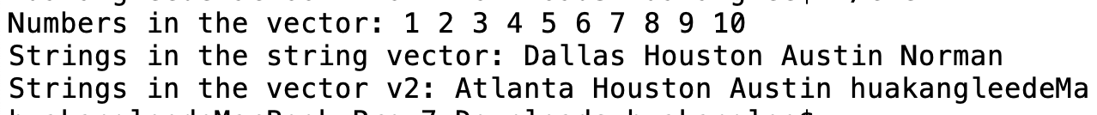
TestVector.cpp
#include <string>
using namespace std;
int main()
{
vector<int> intVector;
// Store numbers 1, 2, 3, 4, 5, ..., 10 to the vector
for (int i = 0; i < 10; i++)
intVector.push_back(i + 1);
// Display the numbers in the vector
cout << "Numbers in the vector: ";
for (int i = 0; i < intVector.size(); i++)
cout << intVector[i] << " ";
vector<string> stringVector;
// Store strings into the vector
stringVector.push_back("Dallas");
stringVector.push_back("Houston");
stringVector.push_back("Austin");
stringVector.push_back("Norman");
// Display the string in the vector
cout << "\nStrings in the string vector: ";
for (int i = 0; i < stringVector.size(); i++)
cout << stringVector[i] << " ";
stringVector.pop_back(); // Remove the last element
vector<string> v2;
v2.swap(stringVector);
v2[0] = "Atlanta";
// Redisplay the string in the vector
cout << "\nStrings in the vector v2: ";
for (int i = 0; i < v2.size(); i++)
cout << v2.at(i) << " ";
return 0;
}

Slide 29
Vector Initializing
In C++11, you can assign values to a vector using a vector initializer, which is similar to an array initializer. For example, the following statement creates a vector with initial values 1 and 9.
vector<int> intVector{1, 9};
vector<vector<int>> matrix{{1, 2, 3},
{4, 5, 6}, {7, 8, 9}, {10, 11, 12}};
C++11: vector initializer in C++11

Slide 30
Replacing Arrays Using the vector Class
A vector is a resizable array. Using vectors is more flexible than arrays. All the examples in the preceding chapters that use arrays can be modified using vectors. This section rewrites Listing 7.2, DeckOfCards.cpp and Listing 8.1, PassTwoDimensionalArray, using vectors.

Slide 31
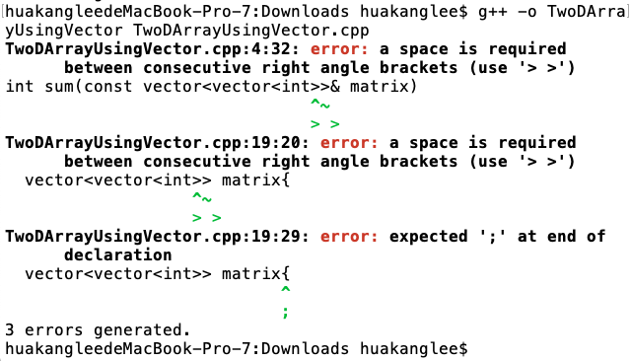
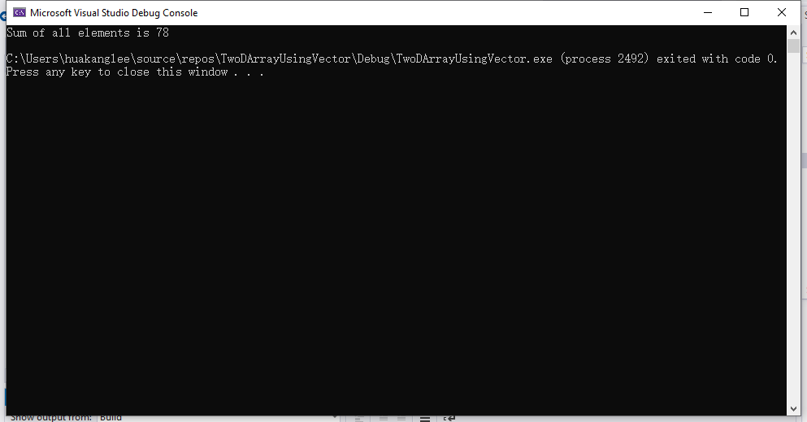
TwoDArrayUsingVector.cpp
#include <iostream>
#include <vector>
using namespace std;
int sum(const vector<vector<int>>& matrix)
{
int total = 0;
for (unsigned int row = 0; row < matrix.size(); row++)
{
for (unsigned column = 0; column < matrix[row].size(); column++)
{
total += matrix[row][column];
}
}
return total;
}
int main()
{
vector<vector<int>> matrix{
{1, 2, 3}, {4, 5, 6}, {7, 8, 9}, {10, 11, 12}};
cout << "Sum of all elements is " << sum(matrix) << endl;
return 0;
}

Slide 32
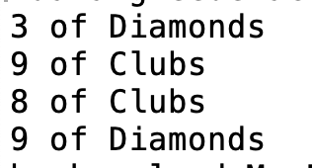
DeckOfCardsUsingVector.cpp
#include <iostream>
#include <vector>
#include <string>
#include <algorithm>
#include <ctime>
using namespace std;
const int NUMBER_OF_CARDS = 52;
string suits[4] = {"Spades", "Hearts", "Diamonds", "Clubs"};
string ranks[13] = {"Ace", "2", "3", "4", "5", "6", "7", "8", "9",
"10", "Jack", "Queen", "King"};
int main()
{
vector<int> deck(NUMBER_OF_CARDS);
// Initialize cards
for (int i = 0; i < NUMBER_OF_CARDS; i++)
deck[i] = i;
// Shuffle the cards
srand(time(0));
random_shuffle(deck.begin(), deck.end());
// Display the first four cards
for (int i = 0; i < 4; i++)
{
cout << ranks[deck[i] % 13] << " of " <<
suits[deck[i] / 13] << endl;
}
return 0;
}

Slide 33
Smart Pointer
C++11
C++11 introduced a new template class named unique_ptr, which functions as a pointer with additional features for automatic memory deallocation.
This is called a smart pointer, since it can automatically destroy the memory for the object when the object is no longer used. Here is an example of creating a smart pointer:

Slide 34
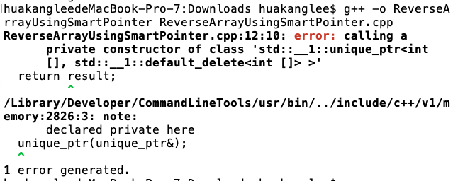
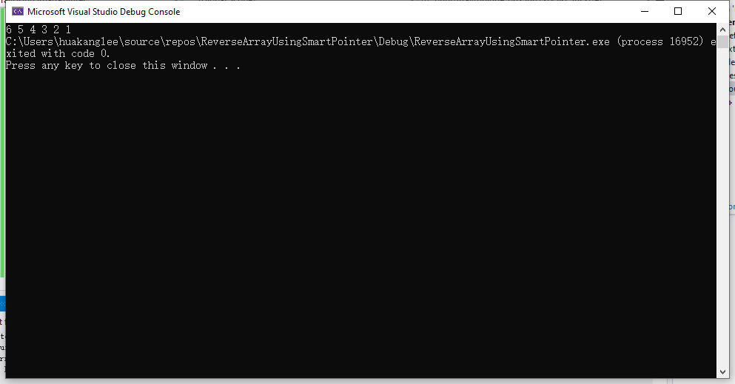
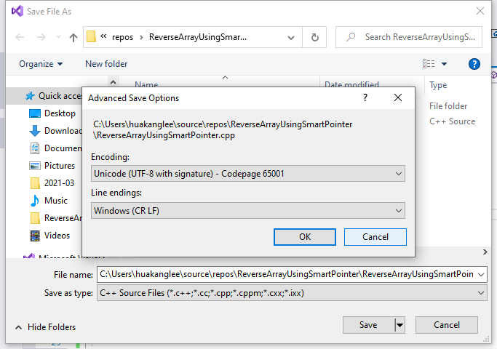
ReverseArrayUsingSmartPointer.cpp
#include <iostream>
#include <memory>
using namespace std;
unique_ptr<int[]> reverse(const int* list, int size)
{
unique_ptr<int[]> result(new int[size]);
for (int i = 0, j = size - 1; i < size; i++, j--)
{
result[j] = list[i];
}
return result;
}
void printArray(unique_ptr<int[]>& list, int size)
{
for (int i = 0; i < size; i++)
cout << list[i] << " ";
}
int main()
{
int list[] = {1, 2, 3, 4, 5, 6};
unique_ptr<int[]> p = reverse(list, 6);
printArray(p, 6);
return 0;
}

Slide 35
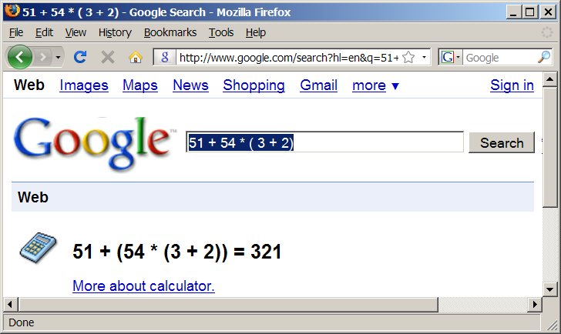
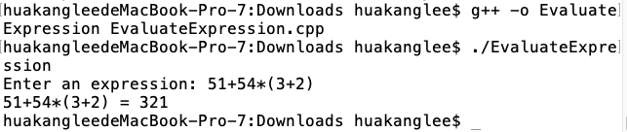
Evaluating Expressions

Slide 36
Algorithm
Phase 1: Scanning the expression
The program scans the expression from left to right to extract operands, operators, and the parentheses.
1.1. If the extracted item is an operand, push it to operandStack.
1.2. If the extracted item is a + or - operator, process all the operators at the top of operatorStack and push the extracted operator to operatorStack.
1.3. If the extracted item is a * or / operator, process the * or / operators at the top of operatorStack and push the extracted operator to operatorStack.
1.4. If the extracted item is a ( symbol, push it to operatorStack.
1.5. If the extracted item is a ) symbol, repeatedly process the operators from the top of operatorStack until seeing the ( symbol on the stack.
Phase 2: Clearing the stack
Repeatedly process the operators from the top of operatorStack until operatorStack is empty.

Slide 37
Example

Slide 38
summarization
Templates Basics
Generic Function
Parameter Type
Stack Class
Vector Class

Slide 39



THANK YOU
Visit us
FOLLOW us
www.xjtlu.edu.cn
Notes:
Title: Uppercase, Calibri size 60, XJTLU Navy

